Slide 1
IPv6 Only
Deployment
Pouria Mousavizadeh Tehrani
Sep
2025
Notes:
Finally, This is 2025, about 50% of Internet on IPv6. Your turn, or everybody switch their provider to one that provides IPv6 without knowing what IPv6 is!

Slide 2

> Whoami
Pouria Mousavizadeh Tehrani,
CTO at Hoopad Cloud (AS214145)
IRNOG Steering Committee Member
Website: spmzt.net
Email: info@spmzt.net
PGP: 0xC7E57F23C24F542D

Slide 3
Agenda
Why IPv6 Only?
The ugly sides of CGNAT
Planning
NAT64
DNS64
Challenges
Thank you

Slide 4
Why IPv6 Only?
Really? Let’s remind everyone fast
Less pain
IPv4 Pool exhaustion. and you know, price
No router-based fragmentation
SLAAC
Simplified header and modern header design, flow label (sdn), extension headers
NO NAT

Slide 5
The ugly CGNAT or NAT444
The RFC 7021 is old now.
IETF informed you 13 years ago about CGNAT consequences
Forget about big service providers. even small ones are migrated.
Notes:
it’s not about ipv6 and not about CGNAT, but it’s about Consequences of our actions are standardized about 13 years ago. How many 4 should I add to my NAT?

Slide 6
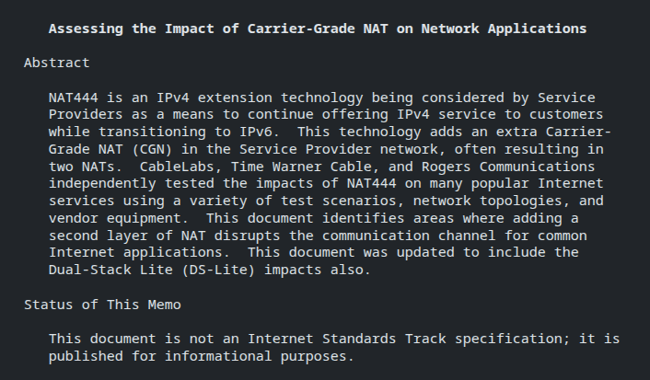
RFC 7021
Notes:
The summary of this RfC is

Slide 7

Notes:
Most of iranian service providers

Slide 8
Why IPv6 Only? - CGNAT
Again, breaks End-to-End Principle, and P2P traffic.
Increases Jitter, latency, and your customer’s sanity.
It leads to NAT-keep alive traffic (NAT punching, NAT traversal mechanisms) on end-users’ local network as well as on the CGNAT device itself.
Increased link utilisation/CPU cycles on the CGNAT device.
Some end-user applications will simply refuse to work or fail miserably like Xbox/PS Networking (P2P Gaming services), etc
Notes:
End-To-End Principle, (I think this is the third time I mentions this in IRNOG)

Slide 9
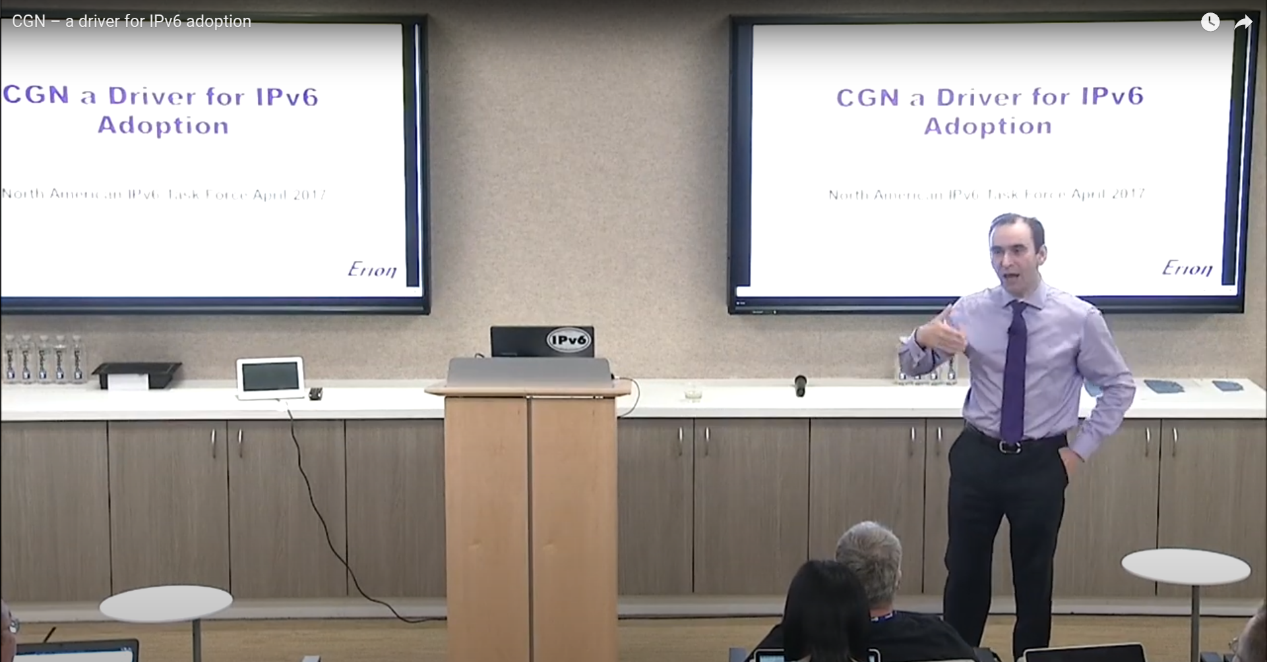
FCP, MNO, Checkout this presentation!
CGN – a driver for IPv6 adoption by Dr. Holder
Notes:
To see how you damages you customers, check this awesome presentation by dr.holder

Slide 10
Planning To Migrate
Request IPv6 Prefix from RIPE.
Plan your IPv6 resources. (Use IPAM)
Sign your IPv6 resources (RPKI).
Make sure you have IPv6 peers.
Assign IPv6 to your customers by default

Slide 11
Address Planning
  ISOC: IPv6 Address Planning: Guidelines for IPv6 address allocation (https://www.internetsociety.org/resources/deploy360/2013/ipv6-address-planning-guidelines-for-ipv6-address-allocation/)
  RIPE NCC: Deploy IPv6 Now (https://www.ripe.net/publications/ipv6-info-centre/deployment-planning/create-an-addressing-plan/)
  RFC 7381: 2.6. Address Plan (https://www.rfc-editor.org/rfc/rfc7381#section-2.6)
  APNIC: IPv6 Architecture and Subnetting Guide (https://blog.apnic.net/2023/04/04/ipv6-architecture-and-subnetting-guide-for-network-engineers-and-operators/)

Slide 12
Address Planning - Our Journey
Why do we do subnetting?
Planning and optimization for routing and security
Keep it simple
Plan for expansion
Ask yourself
Do you want to optimize for your
  security policies?
  router policies and performance?
Do you have a higher or lower quantity of certain type of objects?

Slide 13
Address Planning - Our Journey
Orders of bits
Location bits come first, then type bits:
  smaller routing tables but larger firewall tables
Type bits come first, then location bits:
  smaller firewall tables but larger routing tables
In general: routers can handle large tables better than firewall.

Slide 14
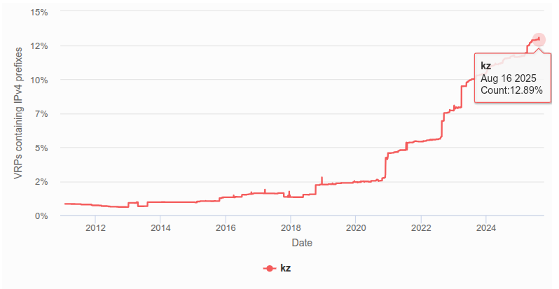
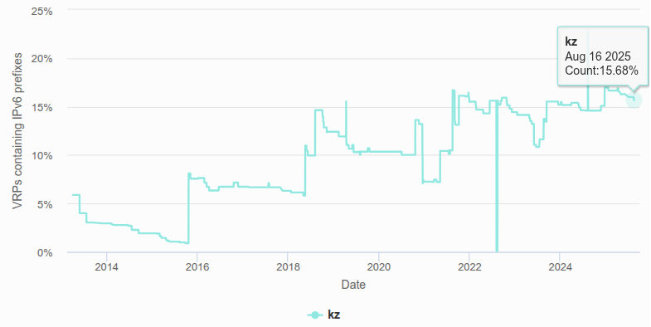
Sign your IPv6 Resources (RPKI)

Slide 15
Make sure you have IPv6 peers
Upstream
IXP
Private Peering
Downstream

Slide 16
Internet Service Providers
Assign IPv6 to your customers by default
Just configure SLAAC.
Don’t assign IPv4 by default. You customer may not want it.
Provide NAT64, and DNS64 facilities instead of CGNAT (or at least beside it)
Your customer want to peer? Send them IPv6 BGP endpoint.
  BGP can have IPv4 address family over IPv6 neighbors.
IPv4 route over IPv6 next-hop (RFC 5549, RFC 7040, RFC 6654, RFC 7600, …)

Slide 17
Route IPv4 packets via IPv6 next-hops
FreeBSD/Linux Servers/Routers
Cisco/Juniper/Huawei Routers
FreeBSD
route add 172.16.0.0/12 -inet6 -gateway 2001:db8::1
Linux
ip route add 172.16.0.0/12 nexthop via inet6 2001:db8::1
Routing Protocols (RFC 5549)
Setup routing peers via IPv6
Enable IPv4 NLRI
Now you have IPv4 routes over IPv6 next-hop
PBR
match your ipv4 prefixes
set ipv6 next-hop

Slide 18
Cloud Providers
Assign IPv6 to your customers by default
Just configure SLAAC.
Prioritize IPv6 in your customer facing panels.
Don’t assign IPv4 by default. You customer may not want it.
Give each customer at least a /48 or /56
Notes:
Hetzner and others won’t assign IPv4 by default. why you do?

Slide 19
CDN Providers
Set IPv6 Anycast on your DNS/Web/Proxy Servers.
Prioritize IPv6 for your downstream connections to customers.
Advertise your services as IP64 CDN Provider.
Why?
Higher minimum MTU, improved performance and speed.
Higher Availability, Native support for anycast

Slide 20
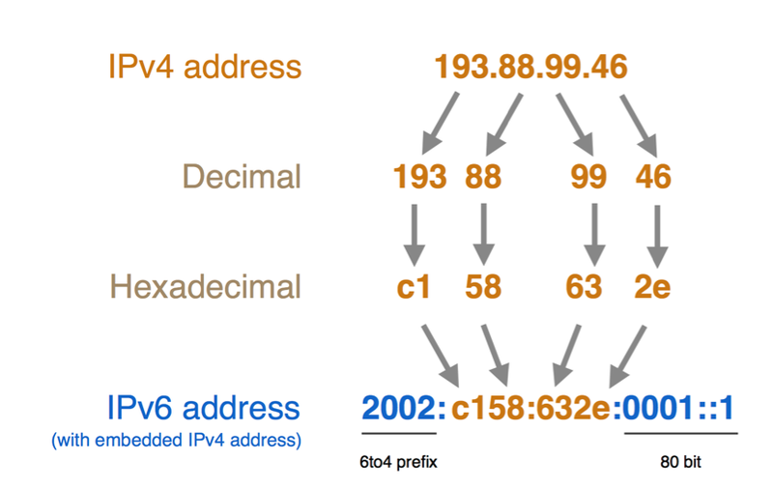
NAT64
IPv6 embedded IPv4
with 128 bits of IPv6, we have plenty of space for 32 bit IPv4 address.

Slide 21
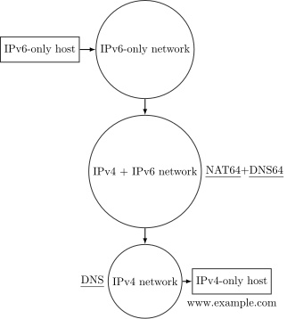
How NAT64 works?
In Summary:
Client add it’s IPv4 at the end of a predefined IPv6 prefix
  2a01:e140:cafe::1.1.1.1 -> 2a01:e140:cafe::101:101
NAT64 router translate it to it’s IPv4 Network and vice versa

Slide 22
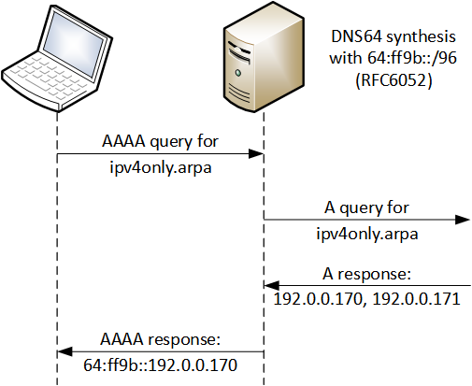
How DNS64 works?
In Summary:
Client make AAAA query to DNS Server
DNS server
  try to resolve AAAA and if it was empty, it tries to query for A record.
  Append the A record respond to it’s NAT64 Prefix.

Slide 23
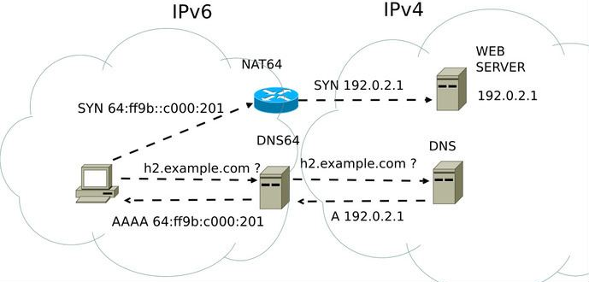
NAT64 + DNS64

Slide 24
Choose your IPv4 in IPv6
IPv4 Redundancy and Path Selection with IPv6!
Use can use your own prefix instead of Well-Known Prefix (WKP) - 64:ff9b::/96
Choose a IPv6 routed prefix from each POP with IPv4 endpoint.
For example:
Datacenter: 2001:db8:a:ff::/96 -> 2001:db8:a:ff::101:101
Branch 1: 2001:db8:1:ff::/96 -> 2001:db8:1:ff::101:101
Branch 2: 2001:db8:2:ff::/96 -> 2001:db8:2:ff::101:101

Slide 25
My Challenges
Couldn’t export netflow over IPv6 connections.
  Due to lack of support for IPv6 kernel socket in FreeBSD Netgraph Network Stack.
OpenBGPd crashes when an interface destroyed (hardware module or tunnel)
  Mostly triggered by link-local addresses.
Linux doesn’t support In-kernel NAT64 and NAT64 of PF firewall was not ready.
  We could do it in userland. However, we wanted to reduce overload for performance.

Slide 26


Slide 27
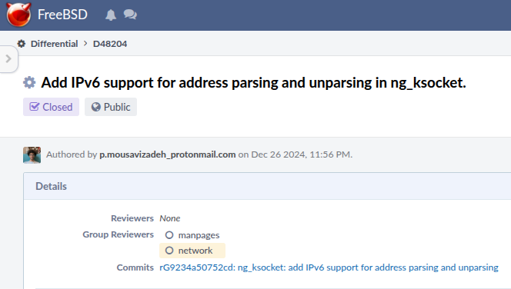
IPv6 Kernel Socket? Done
Implemented the IPv6 for the netgraph ksocket module.
Then we used it to export netflow from our IPv6-only routers to our IPv6-only servers

Slide 28
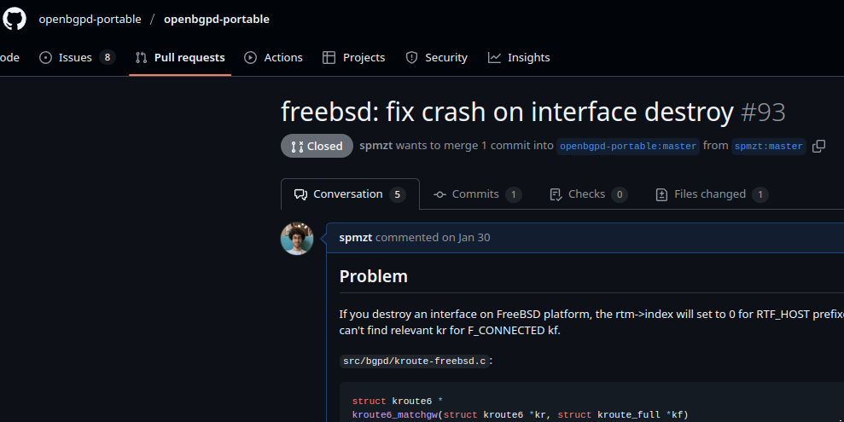
OpenBGP fixed!
The new version of openbgpd is released.
Now works with ephemeral IPv6 enabled interfaces.
You have the fix from 8.8.

Slide 29
Migrate to IPFW or PF
FreeBSD IPFW supports In-Kernel NAT64
Replaced Linux Netfilter with FreeBSD IPFW.
Now FreeBSD’s PF supports NAT64 as well.

Slide 30
THANK YOU!
Pouria Mousavizadeh Tehrani
Hoopad Cloud (AS214145)
Email:
info@spmzt.net

